Slide 1


Talent Acquisition & Management for the Contingent Workforce: What does the future look like?
20 June 2019

Slide 2

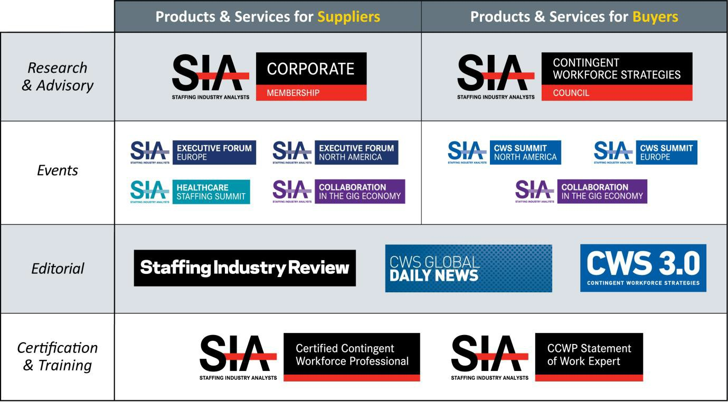
Staffing Industry Analysts Product Overview
SIA | Staffing Industry Analysts Contingent Workforce Strategies Council Webinar

Slide 3

Audio
Listen through your computer by turning on your speakers after you log into the event. Sound will be coming through the audio icon (below left).
DO NOT close this audio broadcast box.
Use the sound bar on the audio broadcast box to adjust the volume.
Need assistance? Please let us know in the
Q&A section.
SIA | Staffing Industry Analysts Contingent Workforce Strategies Council Webinar

Slide 4
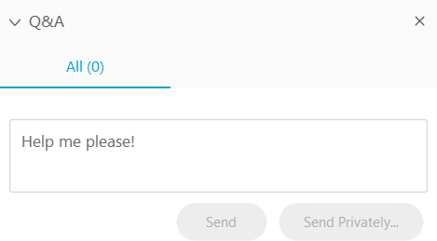
Questions?
Questions may be submitted at any time.
Click on the Question Mark section
to open the Q&A window.
Type your question into the small dialog box and click the Send Button.
The presentation will be shared with registrants.
SIA | Staffing Industry Analysts Contingent Workforce Strategies Council Webinar

Slide 5


Moderator:
Peter Reagan, CCWP & SOW Management Expert
Senior Director of Contingent Workforce Strategies & Research, SIA
Alastair Dobson
Senior Client Relationship Manager, Beeline
Speaker:
20 June 2019

Slide 6

Key Trends
Growth in VMS and MSP Spend Under Management
Total Talent Acquisition
Statement of Work
Contingent Workforce Becoming More Strategic
HR and Talent Acquisition
The Danger of Programme Complacency
The Online Talent Economy
SIA | Staffing Industry Analysts Contingent Workforce Strategies Council

Slide 7
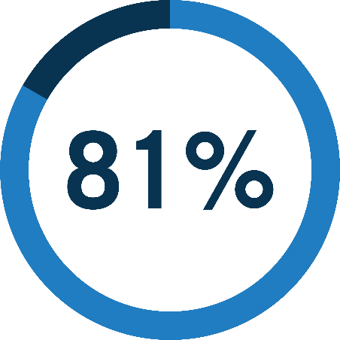

VMS
MSP
SIA | Staffing Industry Analysts Contingent Workforce Strategies Council

Slide 8

MSP
131b+
13% (EMEA)
VMS
154b+
14% (EMEA)
Source: SIA MSP & VMS Market Developments Pt2 2018
SIA | Staffing Industry Analysts Contingent Workforce Strategies Council

Slide 9


Total Talent Acquisition
SIA | Staffing Industry Analysts Contingent Workforce Strategies Council

Slide 10

Statement of Work
SIA | Staffing Industry Analysts Contingent Workforce Strategies Council

Slide 11

Contingent is Strategic
SIA | Staffing Industry Analysts Contingent Workforce Strategies Council

Slide 12

Arise HR &
Talent Acquisition
SIA | Staffing Industry Analysts Contingent Workforce Strategies Council

Slide 13

SIA | Staffing Industry Analysts Contingent Workforce Strategies Council

Slide 14

The Danger of Programme Complacency
SIA | Staffing Industry Analysts Contingent Workforce Strategies Council

Slide 15

Technology and the Online Talent Economy
SIA | Staffing Industry Analysts Contingent Workforce Strategies Council

Slide 16
Discovery Engagement
System of Record
Assessment Verification
SIA | Staffing Industry Analysts Contingent Workforce Strategies Council
Source: SIA Talent Acquisition Technology Ecosystem 2018

Slide 17
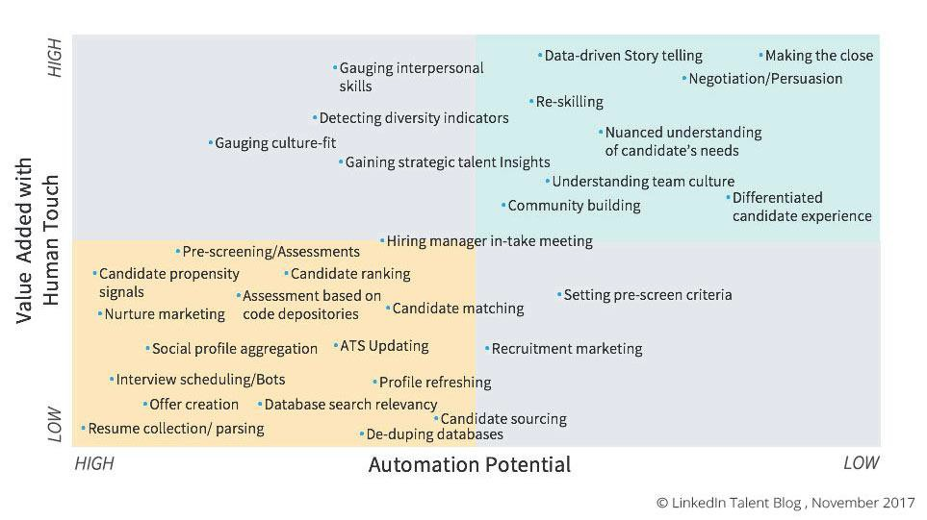
SIA | Staffing Industry Analysts Contingent Workforce Strategies Council

Slide 18
Looking Forward
AI-powered experiences

Slide 19

Using AI to assist, accelerate and augment human capital decisions and workflows.
Human-centric AI
Notes:
Human-centric AI is a key part of our digital transformation strategy. Using AI to assist, accelerate and augment human capital decisions and workflows.

Slide 20
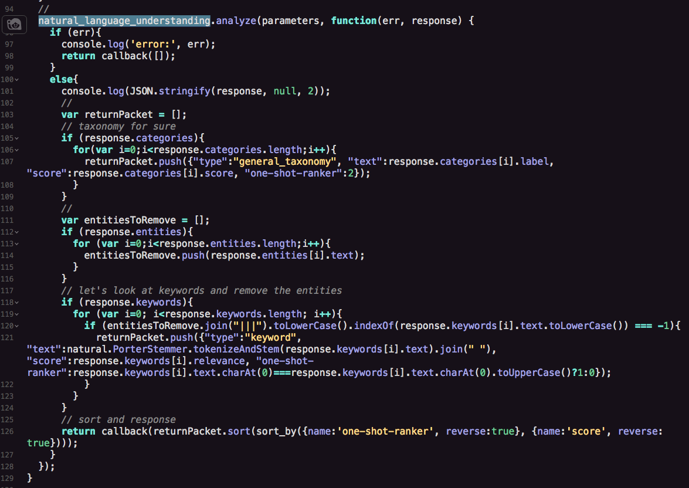
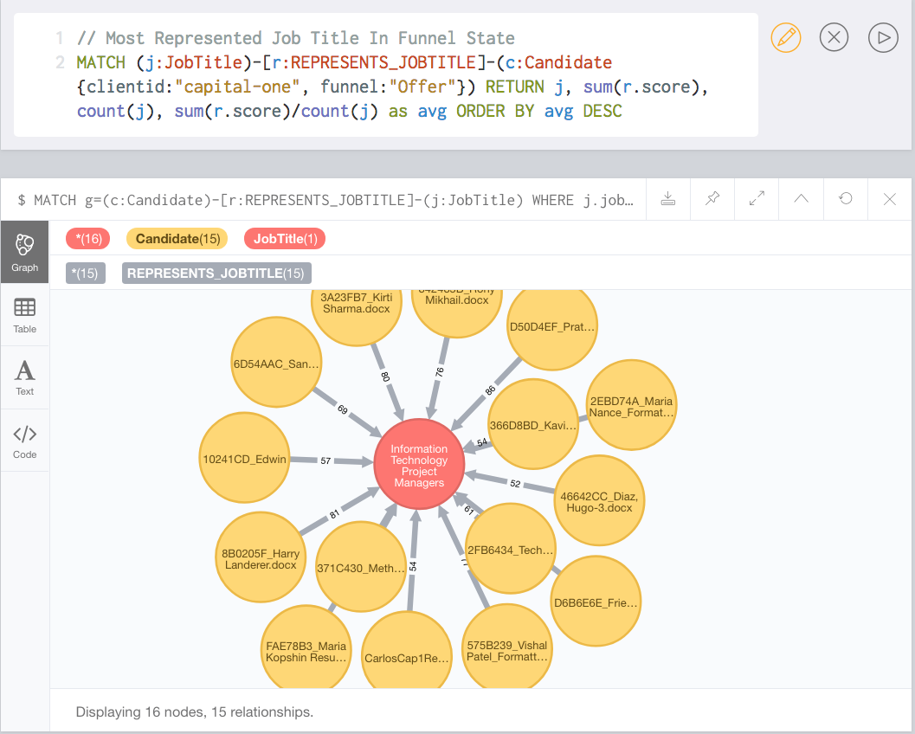
Notes:
This slide is meant to provide some clarity around Knowledge Graph being a capability and not a feature. It’s not something you “demo” directly.
(Some companies talk about charging clients for enhancing their products with AI. We see AI capabilities – knowledge representation, machine learning, natural language processing, etc.) as tools in our toolkit that we apply – at no additional cost -- to augment what our clients can do with our products.

Slide 21
This is Beeline knowledge graph
Notes:
This slide is meant to provide some clarity around Knowledge Graph being a capability and not a feature. It’s not something you “demo” directly.
(Some companies talk about charging clients for enhancing their products with AI. We see AI capabilities – knowledge representation, machine learning, natural language processing, etc.) as tools in our toolkit that we apply – at no additional cost -- to augment what our clients can do with our products.

Slide 22
THE JOB DESCRIPTION
WILL DIE
AS YOU KNOW IT
Notes:
With augmented intelligence, the job description – as we know it today – will die.
We all know that hiring managers are horrible at writing job descriptions. They either don’t have time or they don’t have the skills. And, in the end, it’s really not their job. Their job is to get someone in to complete an outcome.
And we have the ability – with the amount of data that we have and the learnings we’ve been able to glean from that over the last 20 years – we can actually identify (based on a hiring manager’s performance and their behavior and their selection process) – we can actually identify what a candidate for a specific outcome will look like.
So in the next 12 to 24 months, we foresee the job description will be GONE. Instead, we see the manager saying I see my ideal candidate for this outcome.
Of course it requires a lot of data to train the models, but after 20 years, we have the data.

Slide 23
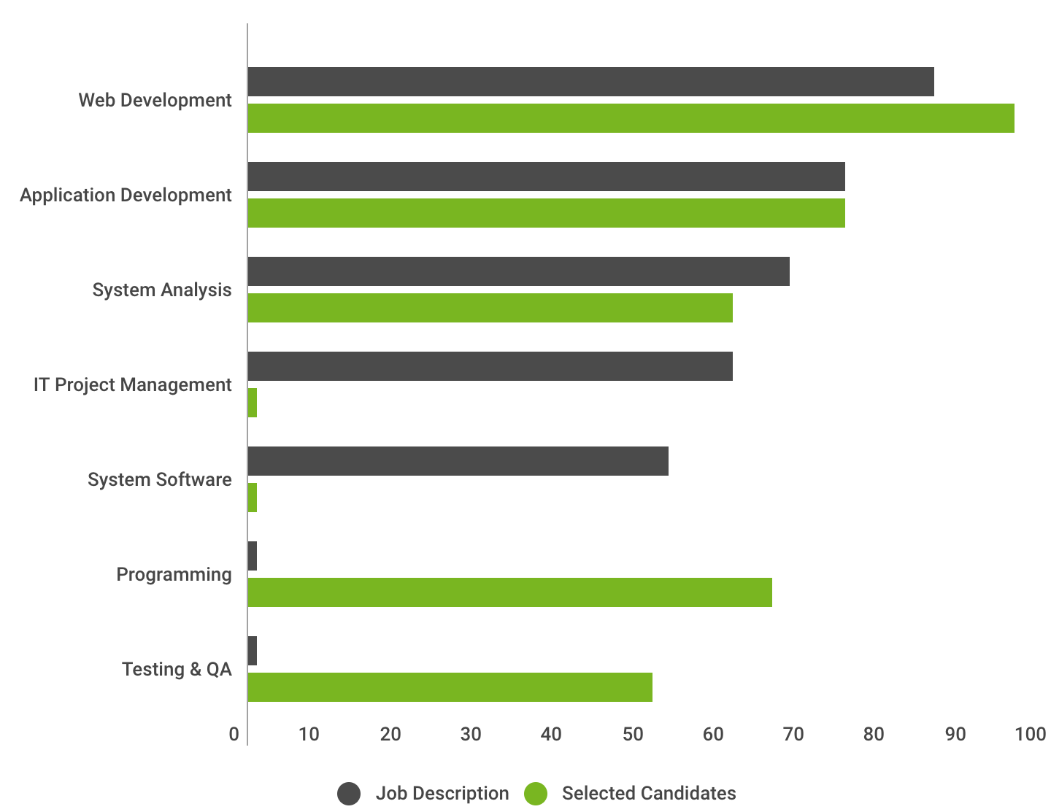
How did a large consultancy hire their Java Developers?
Testing & QA was a significant success factor – and was never mentioned in job descriptions.
Notes:
In one of our studies, a large consultancy had a role to fill that was identified as a “Java Developer”.
As you can see on this chart…the job description (dark gray) was heavily focused on web development and application development…even IT project management.
So, suppliers were submitting enterprise java engineers.
But, the job description was misleading. The department was actually looking for Test Automation Engineers that knew Java (green). That’s a very different candidate.
The managers wasted hours in interviews, the suppliers churned through more than 50 candidates…just to narrow down WHAT the manager actually wanted.
What a waste of time!

Slide 24
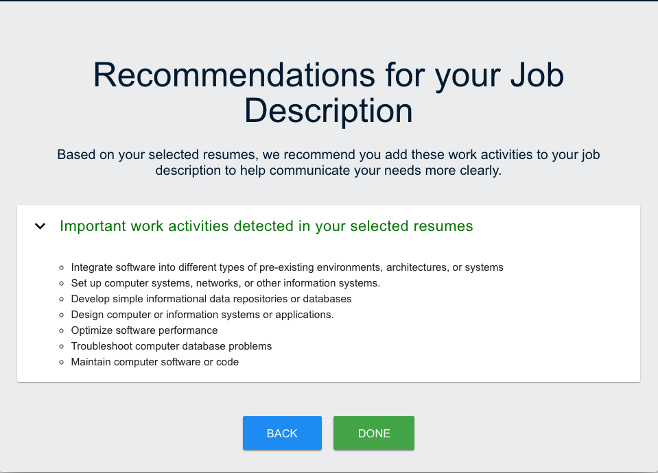
Can AI write a smarter job description?
Yes! Data signals indicated focus on “work activities” over job description.
Notes:
With Beeline Knowledge Graph, we were able to isolate both the work activities (testing) and the skills (java).
So, how can we use these learnings to TRANSFORM how we use job descriptions? We can generate a natural language job description that focuses on work activities of prior workers…this will give suppliers a better idea of what kind of candidates to submit and can better power matching algorithms.

Slide 25
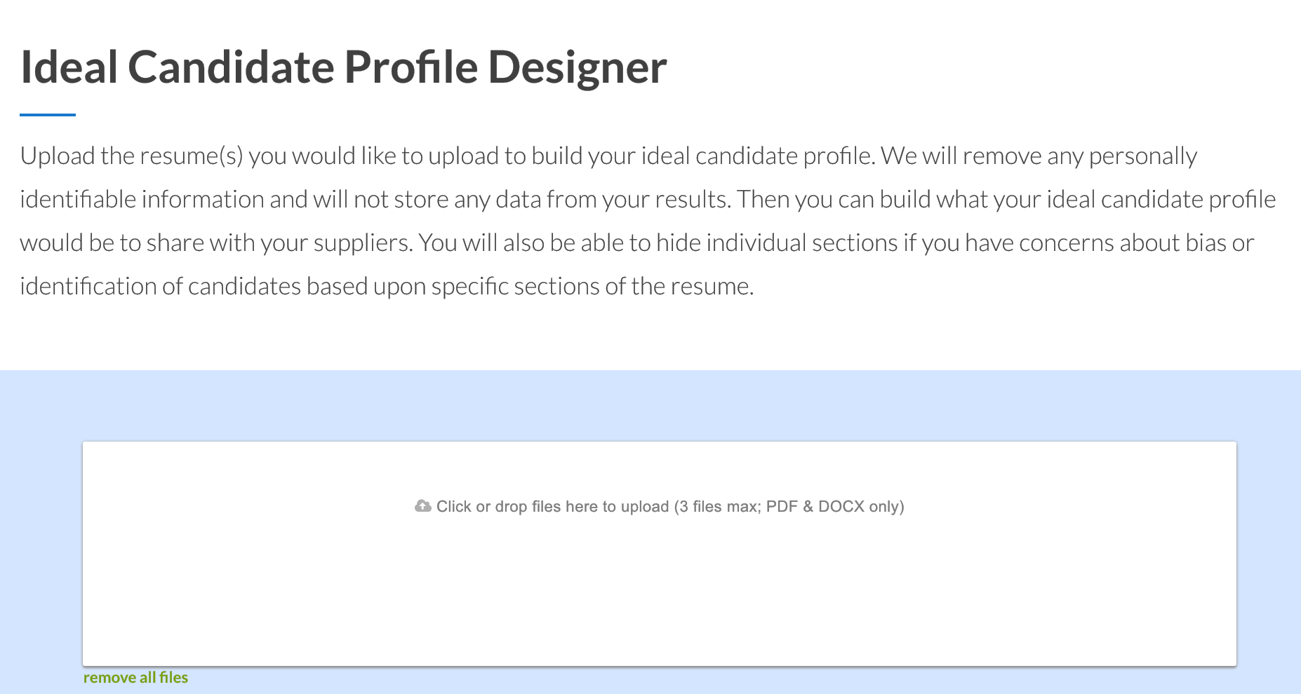
Notes:
We have built and are testing a simple tool to drag and drop resumes of successful candidates in order to generate an “ideal candidate profile” to accompany your job description.

Slide 26
Concierge Solutions
AI enabling a personal experience
Notes:
In consumer applications, AI is enabling personalized concierge experiences. Think of personal assistants like Siri, Alexa, and Google. Think of transactional AI in applications like Amazon or Netflix – analyzing billions of bits of data to suggest products you might like to buy or films you might like to watch.
We’re now applying similar technology to personalize the experience of acquiring and managing contingent talent.

Slide 27
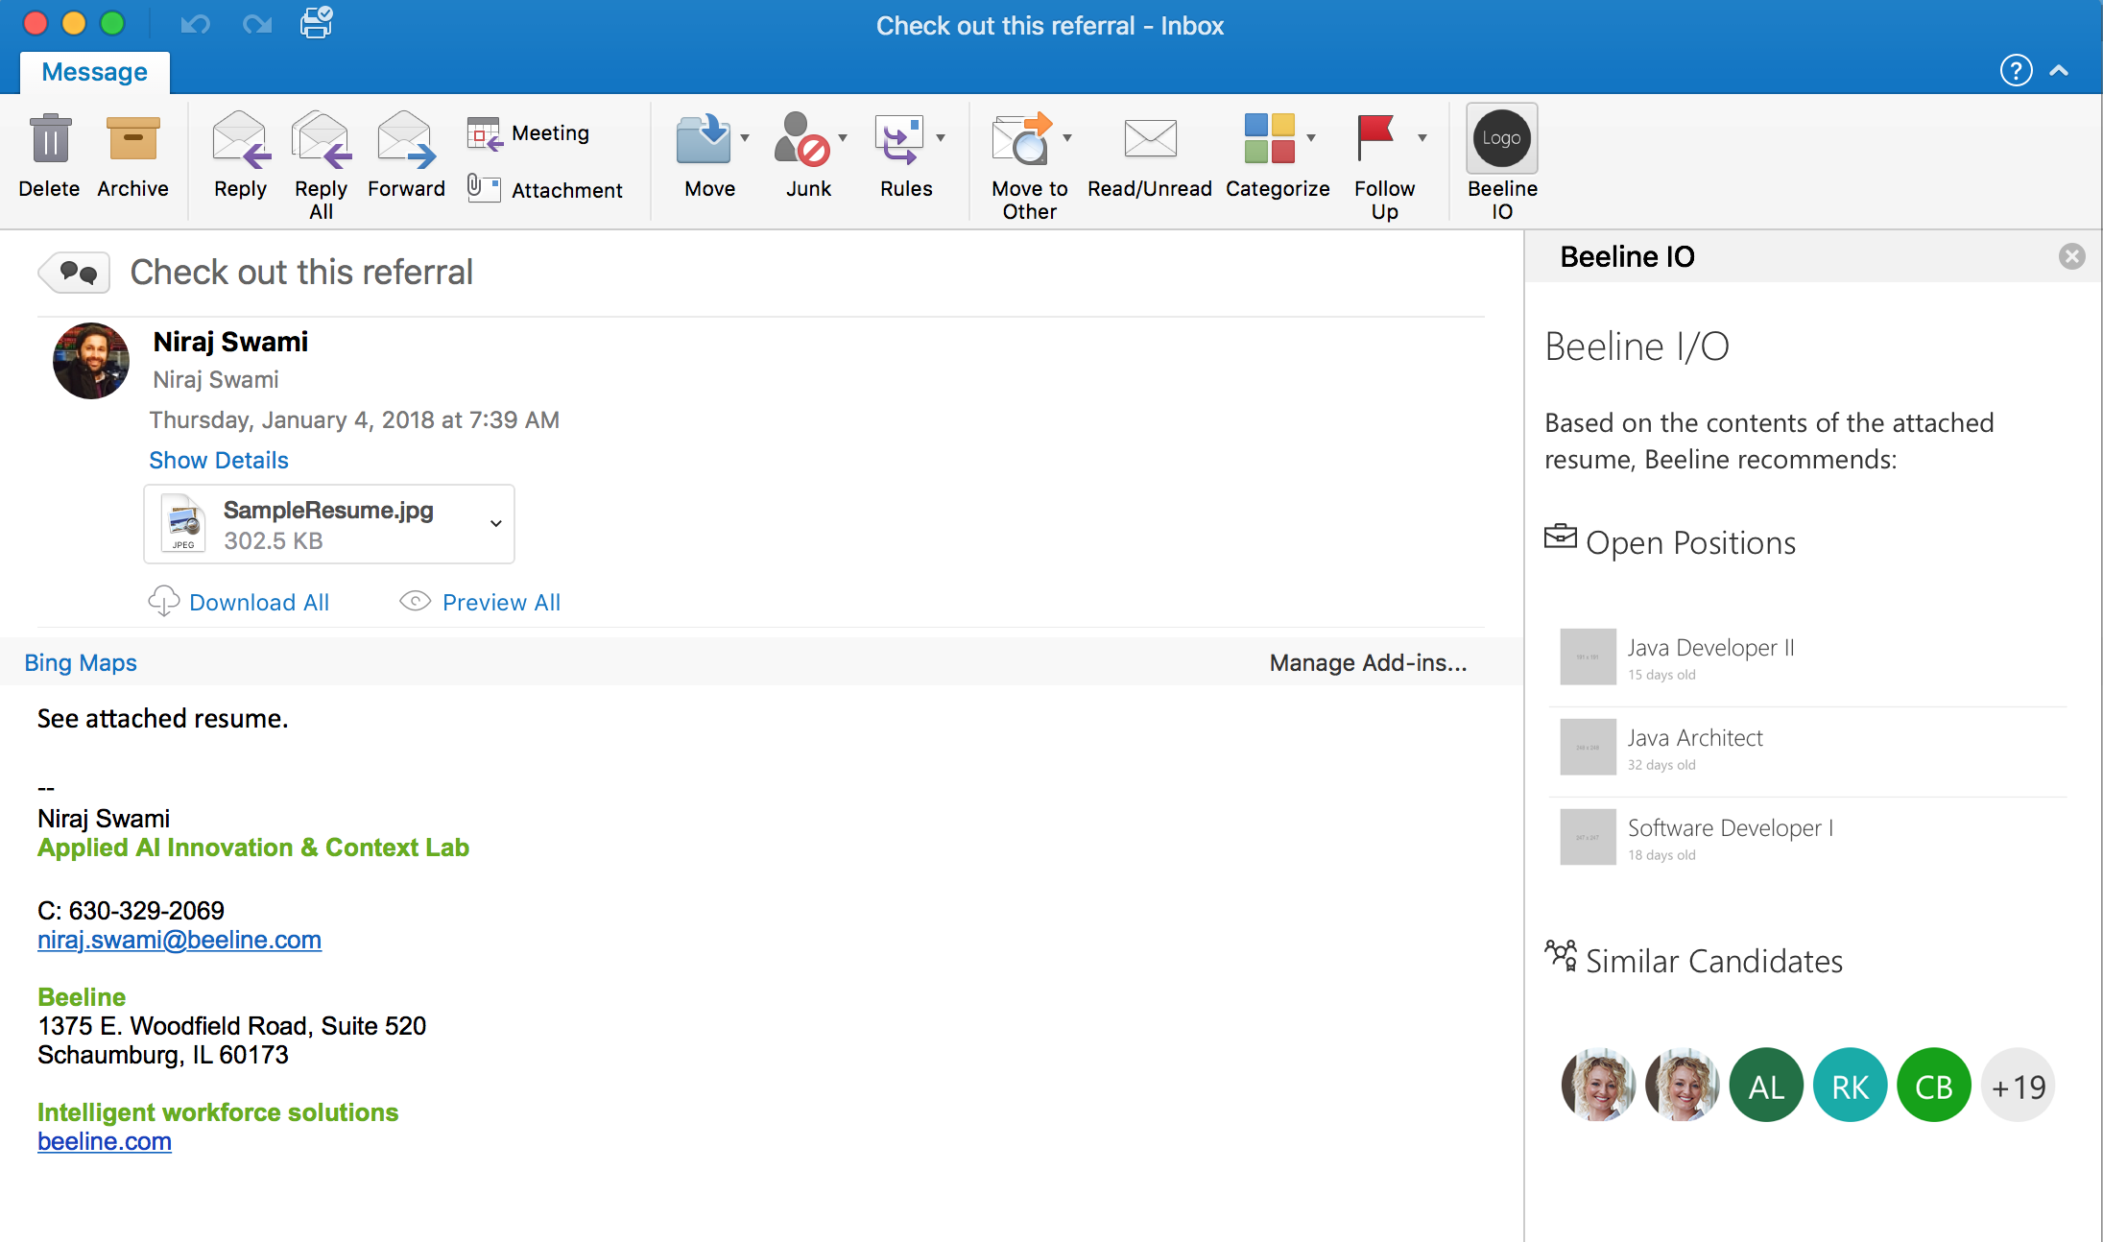
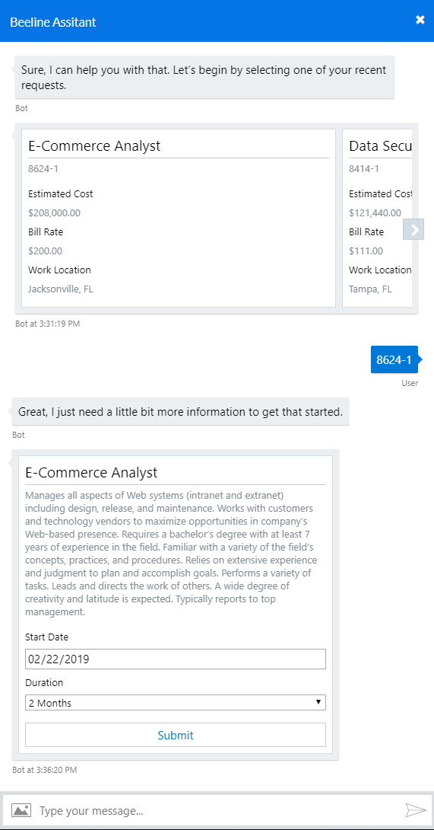

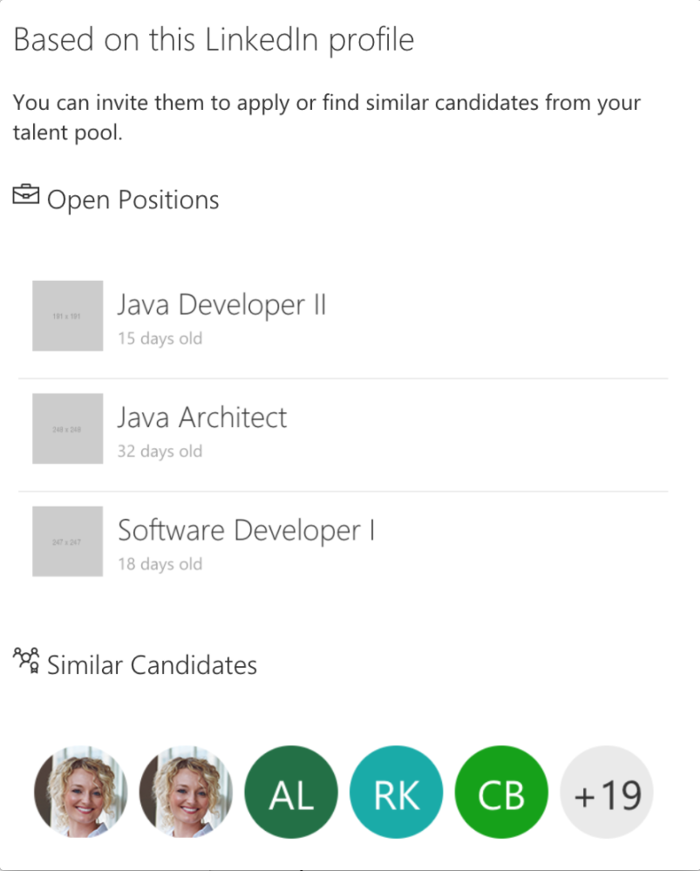
Beeline Knowledge Graph + Outlook (matching)
Notes:
Like, an Outlook widget that tells you what jobs in your company are a good fit for the resume you received in an email from your co-worker who said “my brother’s neighbor’s roommate would be a great fit for this company!”

Slide 28
Beeline Bot & Outlook Plugin (create position)
NLP / Bot
Notes:
Like, an Outlook plugin lets your managers open a new position and route it for approval in one click!
(Note: NLP stands for “natural language processing”)
.

Slide 29
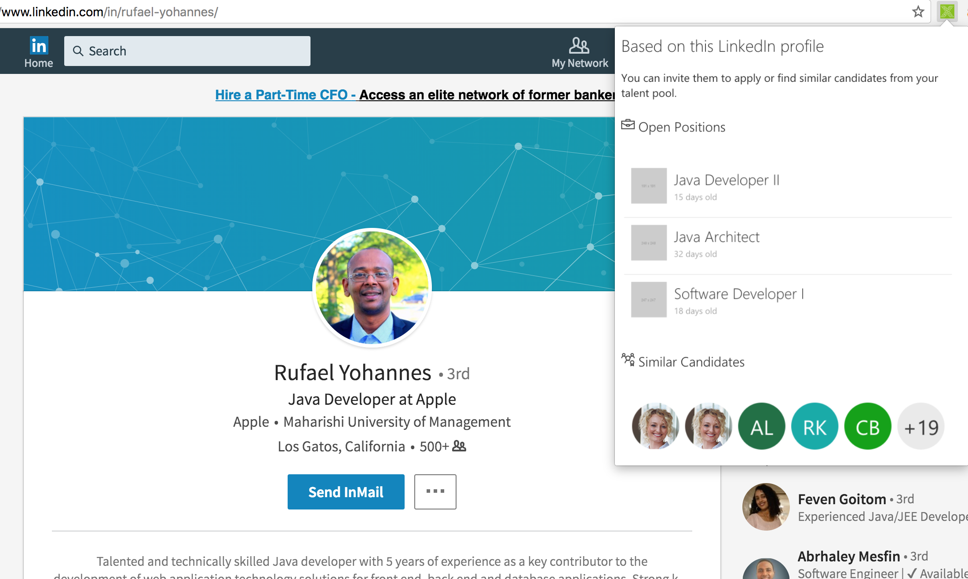
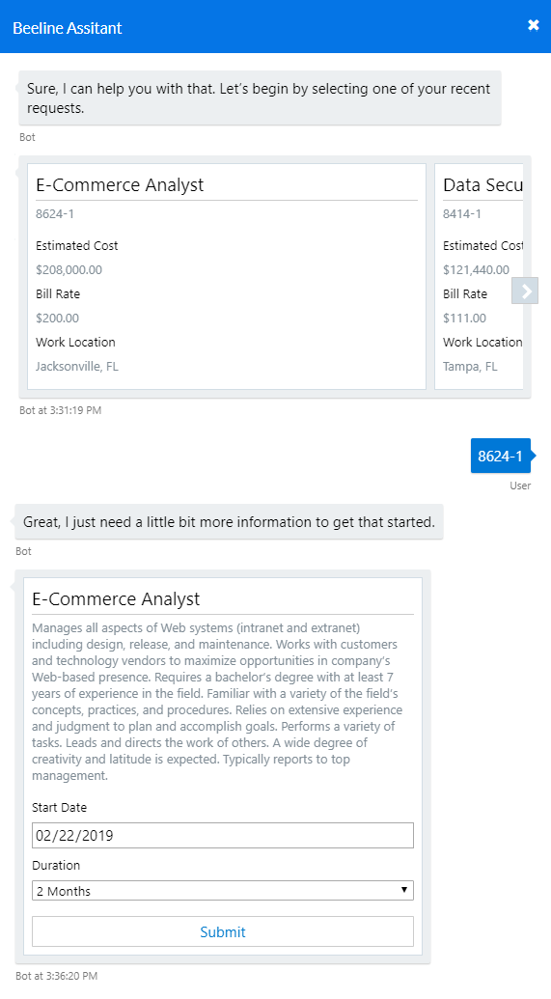
Beeline Knowledge Graph + Browser plugin for
LinkedIn
Notes:
Like, a web-browser plugin that shows you which jobs in your company are a good fit for the LinkedIn profile connection invite you just received.
All these concepts you’ve seen are about augmenting human intelligence with artificial intelligence to engage talent – working smarter, not harder, and a lot more efficiently.

Slide 30
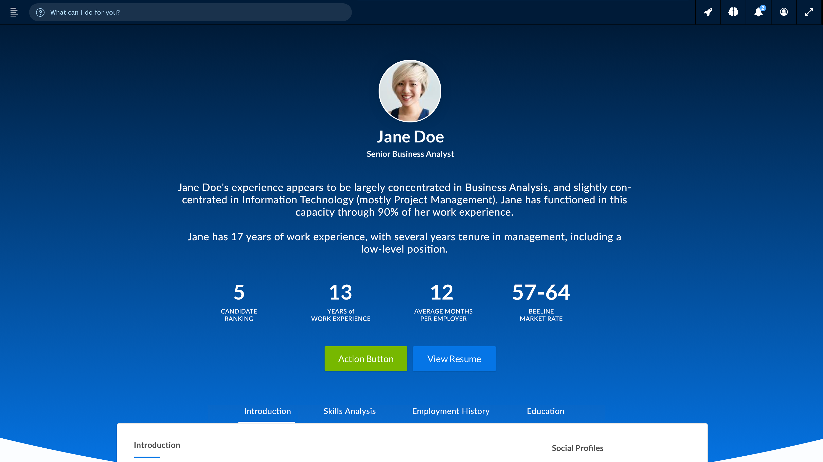
Notes:
This page highlights how Digital transformation, our Spectrum of Workforce Analytics and Applied AI (knowledge graph) come together into a cohesive user experience. It also shows how we prefer to use an “Army of A.I.” (multiple readily available and constantly updated AI sources, like Google and IBM’s Watson) rather than one single, proprietary AI technology to extract and interpret relevant data.
(Note: NLG stands for “natural language generator”)

Slide 31
NLG
Extraction AI
Notes:
This page highlights how Digital transformation, our Spectrum of Workforce Analytics and Applied AI (knowledge graph) come together into a cohesive user experience. It also shows how we prefer to use an “Army of A.I.” (multiple readily available and constantly updated AI sources, like Google and IBM’s Watson) rather than one single, proprietary AI technology to extract and interpret relevant data.
(Note: NLG stands for “natural language generator”)

Slide 32
Google / IBM
Prediction AI
Notes:
This page highlights how Digital transformation, our Spectrum of Workforce Analytics and Applied AI (knowledge graph) come together into a cohesive user experience. It also shows how we prefer to use an “Army of A.I.” (multiple readily available and constantly updated AI sources, like Google and IBM’s Watson) rather than one single, proprietary AI technology to extract and interpret relevant data.
(Note: NLG stands for “natural language generator”)

Slide 33
“How can I help you?”
Replaces navigation and form fills
Notes:
AI enables the next frontier in user experience….concierge enterprise software – software that anticipates your needs based on past experience (yours specifically, plus others in similar roles).

Slide 34
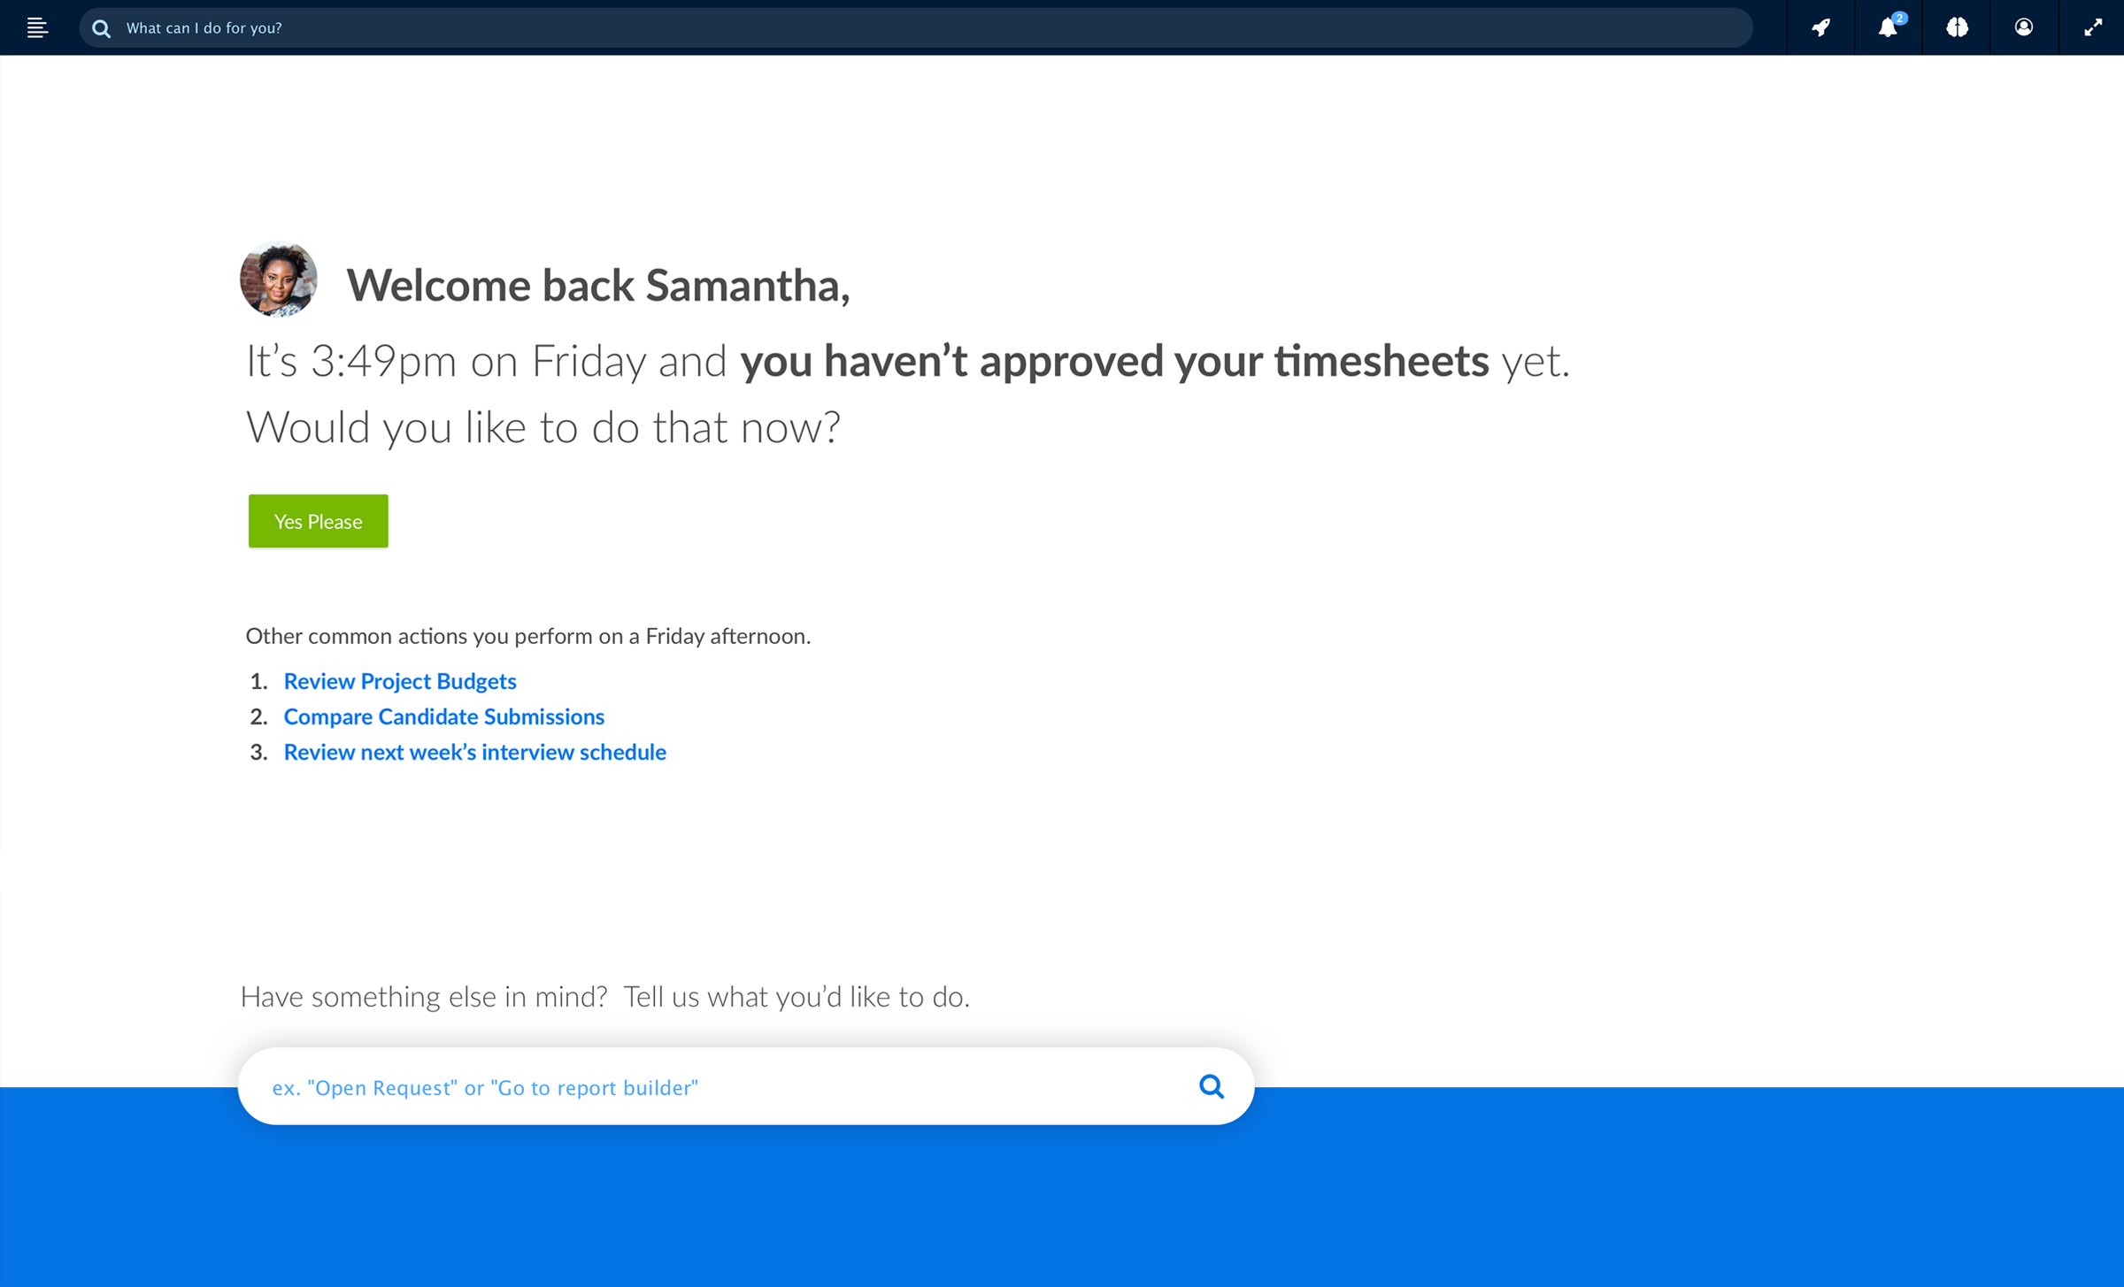
Convergence: UI Evolution

Slide 35
Convergence: UI Evolution
Prediction AI
Prediction AI

Slide 36
Convergence: UI Evolution
Federated Search, NLP, Bot
NLP, NLG
IBM Watson
Google AI
Extraction AI

Slide 37
Convergence: UI Evolution
NLP / Bot

Slide 38
Workforce technology undergoing digital transformation
VMS evolution is taking 2 different directions
spend-focused/e-procurement technology track
talent-focused, agile workforce technology track
Human-centric AI
  augment human capital decisions
  accelerate workflows
  assist talent identification & selection
Direct sourcing opens up more talent channels
Analytics unlock potential of your workforce data
Notes:
We (Beeline) see VMS evolution diverging – with some providers focusing primarily on spend management and others focusing primarily on talent acquisition and total workforce optimization.

Slide 39

Time for Your Questions…
SIA | Staffing Industry Analysts Contingent Workforce Strategies Council Webinar

Slide 40
Useful Resources
SIA Resources:
MSP Market Developments Part One
MSP Market Developments Part Two
VMS Market Developments Part One
VMS Market Developments Part Two
The Gig Economy and Human Cloud Landscape: 2018 Update
Contact the SIA CWS Council team at enterpriseservices@staffingindustry.com
SIA | Staffing Industry Analysts Contingent Workforce Strategies Council Webinar

Slide 41




9-12 September 2019 | San Diego, CA | Manchester Grand Hyatt | @CWSSummit @SIAGigE
Register Now for San Diego!
Join your peers at the annual CWS Summit, the largest North American networking event
for contingent and workforce solutions professionals, followed by the award-winning
Collaboration in the Gig Economy conference where all players ​in the workforce solutions ecosystem connect and optimise the talent supply chain.
Register now at www.cwssummit.com

Slide 42

View the full schedule of classes at:
www.staffingindustry.com/certification
@SIACCWP #CCWP
Invest in Your Future. Today.
CCWP is fast becoming the industry’s most sought after accreditation. It unifies a common language, and draws a road map for your continuous improvement in contingent workforce programmes.
Register Today!
13-14 August | Melbourne, Australia
19-20 August | Calgary, Canada
22-23 October | London, UK

Slide 43

View the full schedule of classes at:
www.staffingindustry.com/certification
@SIACCWP #CCWP
Expand Your Expertise in SOW. Now.
The CCWP SOW Management Expert Certification provides you with strategies to control costs and enhance project/services engagement quality within your programmes. The certification will further test your comprehension of managing SOW engagements.
Register Today!
7-8 August | Sydney, Australia
21-22 August | Calgary, Canada
21-22 November | London, UK

Slide 44

Industry Insights from the Comfort of Your Office!
Webinars focus on a variety of relevant contingent labour topics from industry developments and forecasts to ideas, techniques and insights.
2019 Dates:
• 25 September
• 13 November
• 17 December
View webinar topics and sign up at:
www.staffingindustry.com/webinars-buyer

Slide 45


Calling all Contingent
Workforce Programme Game Changers!
Nominate yourself, a peer, or client!
Nominations Now Open!
https://www.surveymonkey.com/r/GameChangers2019

Slide 46

Copies of the slides and a link to the audio recording will be distributed to all attendees within 48 hours following the webinar.
A replay of this webinar will be available for our CWS Council and Premium Corporate members at: www.staffingindustry.com/webinars-buyer
SIA | Staffing Industry Analysts Contingent Workforce Strategies Council Webinar

Slide 47





About Staffing Industry Analysts (SIA)
Founded in 1989, SIA is the global advisor on staffing and workforce solutions. Our proprietary research covers all categories of employed and non-employed work including temporary staffing, independent contracting and other types of contingent labor. SIA’s independent and objective analysis provides insights into the services and suppliers operating in the workforce solutions ecosystem including staffing firms, managed service providers, recruitment process outsourcers, payrolling/compliance firms and talent acquisition technology specialists such as vendor management systems, online staffing platforms, crowdsourcing and online work services. We also provide training and accreditation with our unique Certified Contingent Workforce Professional (CCWP) program.
Known for our award-winning content, data, support tools, publications, executive conferences and events, we help both suppliers
and buyers of workforce solutions make better-informed decisions that improve business results and minimize risk.
As a division of the international business media company, Crain Communications Inc., SIA is headquartered in Mountain View, California, with offices in London, England.
For more information: www.staffingindustry.com
For global coverage across the workforce solutions ecosystem, follow us and connect via
@SIAnalysts
PROPRIETARY DATA, DO NOT DISTRIBUTE OUTSIDE YOUR ORGANIZATION. Your company’s use of this report precludes distribution of its contents, in whole or in part, to other companies or individuals outside your organization
in any form – electronic, written or verbal – without the express written permission of Staffing Industry Analysts. It is your organization’s responsibility to maintain and protect the confidentiality of this report.
Staffing Industry Analysts | 1975 W. El Camino Real, Ste. 304 | Mountain View, CA 94040 | 800.950.9496 | www.staffingindustry.com
SIA | Staffing Industry Analysts Contingent Workforce Strategies Council Webinar

